Slide 1
Chapter 9 – Software Evolution
Lecture 1

Slide 2
Topics covered
Evolution processes
Change processes for software systems
Program evolution dynamics
Understanding software evolution
Software maintenance
Making changes to operational software systems
Legacy system management
Making decisions about software change

Slide 3
Software change
Software change is inevitable
New requirements emerge when the software is used;
The business environment changes;
Errors must be repaired;
New computers and equipment is added to the system;
The performance or reliability of the system may have to be improved.
A key problem for all organizations is implementing and managing change to their existing software systems.

Slide 4
Importance of evolution
Organizations have huge investments in their software systems - they are critical business assets.
To maintain the value of these assets to the business, they must be changed and updated.
The majority of the software budget in large companies is devoted to changing and evolving existing software rather than developing new software.

Slide 5
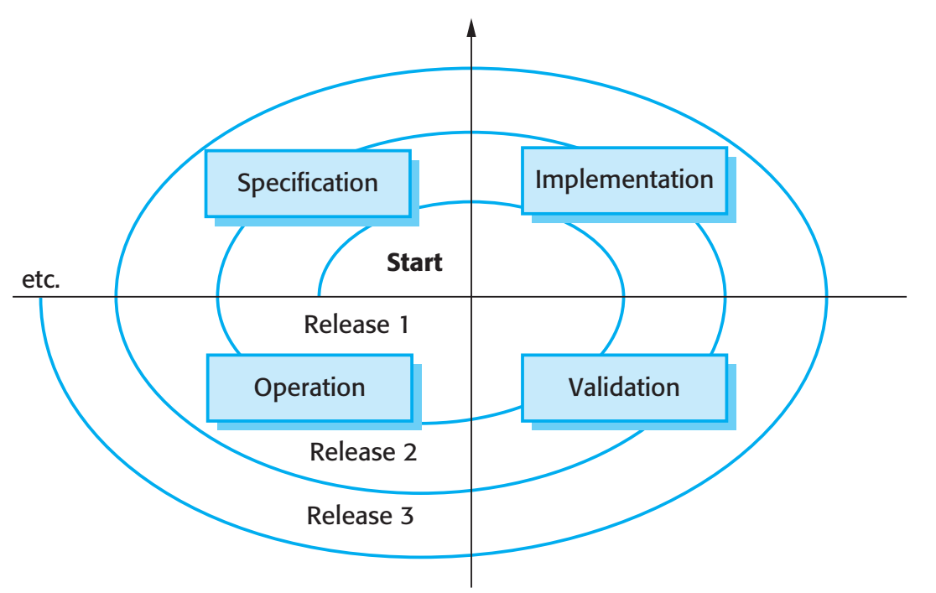
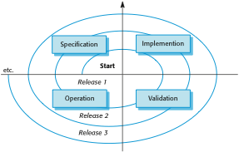
A spiral model of development and evolution

Slide 6
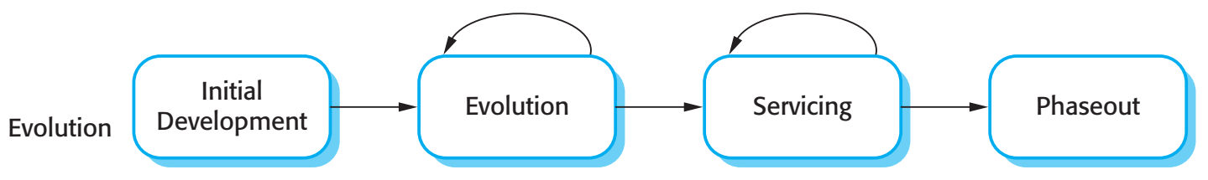

Evolution and servicing

Slide 7
Evolution and servicing
Evolution
The stage in a software system’s life cycle where it is in operational use and is evolving as new requirements are proposed and implemented in the system.
Servicing
At this stage, the software remains useful but the only changes made are those required to keep it operational i.e. bug fixes and changes to reflect changes in the software’s environment. No new functionality is added.
Phase-out
The software may still be used but no further changes are made to it.

Slide 8
Evolution processes
Software evolution processes depend on
The type of software being maintained;
The development processes used;
The skills and experience of the people involved.
Proposals for change are the driver for system evolution.
Should be linked with components that are affected by the change, thus allowing the cost and impact of the change to be estimated.
Change identification and evolution continues throughout the system lifetime.

Slide 9
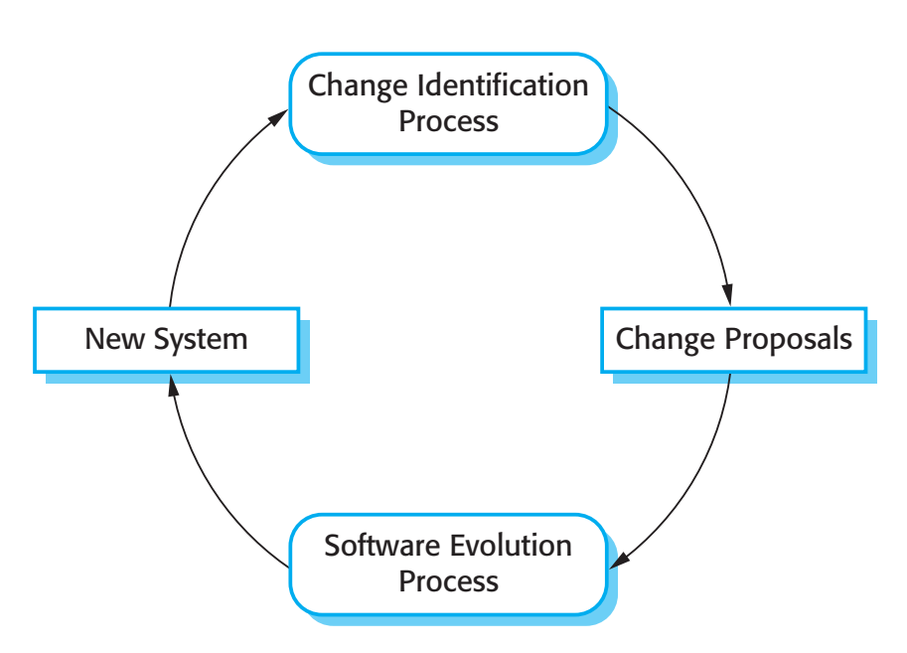
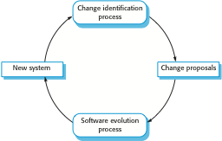
Change identification and evolution processes

Slide 10
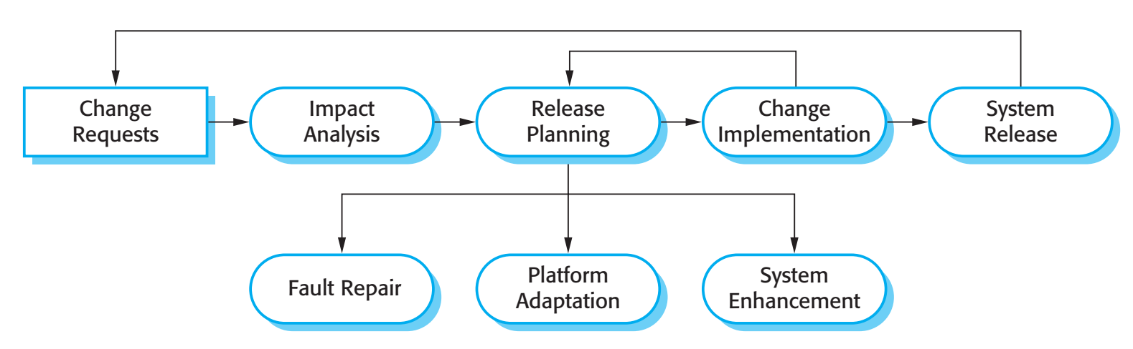
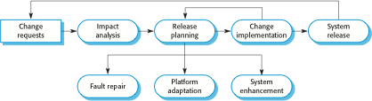
The software evolution process

Slide 11
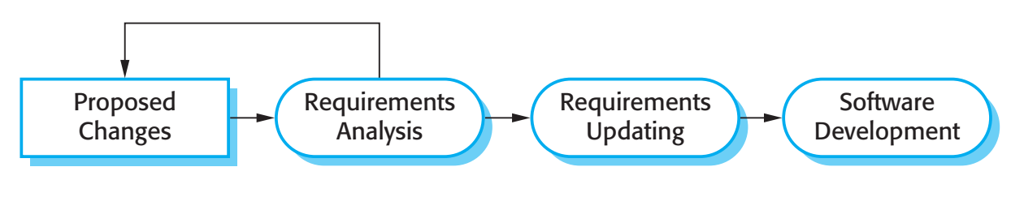

Change implementation

Slide 12
Change implementation
Iteration of the development process where the revisions to the system are designed, implemented and tested.
A critical difference is that the first stage of change implementation may involve program understanding, especially if the original system developers are not responsible for the change implementation.
During the program understanding phase, you have to understand how the program is structured, how it delivers functionality and how the proposed change might affect the program.

Slide 13
Urgent change requests
Urgent changes may have to be implemented without going through all stages of the software engineering process
If a serious system fault has to be repaired to allow normal operation to continue;
If changes to the system’s environment (e.g. an OS upgrade) have unexpected effects;
If there are business changes that require a very rapid response (e.g. the release of a competing product).

Slide 14
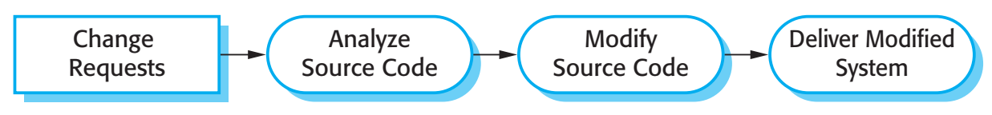
The emergency repair process

Slide 15
Agile methods and evolution
Agile methods are based on incremental development so the transition from development to evolution is a seamless one.
Evolution is simply a continuation of the development process based on frequent system releases.
Automated regression testing is particularly valuable when changes are made to a system.
Changes may be expressed as additional user stories.

Slide 16
Handover problems
Where the development team have used an agile approach but the evolution team is unfamiliar with agile methods and prefer a plan-based approach.
The evolution team may expect detailed documentation to support evolution and this is not produced in agile processes.
Where a plan-based approach has been used for development but the evolution team prefer to use agile methods.
The evolution team may have to start from scratch developing automated tests and the code in the system may not have been refactored and simplified as is expected in agile development.

Slide 17
Program evolution dynamics
Program evolution dynamics is the study of the processes of system change.
After several major empirical studies, Lehman and Belady proposed that there were a number of ‘laws’ which applied to all systems as they evolved.
There are sensible observations rather than laws. They are applicable to large systems developed by large organisations.
It is not clear if these are applicable to other types of software system.

Slide 18
Change is inevitable
The system requirements are likely to change while the system is being developed because the environment is changing. Therefore a delivered system won't meet its requirements!
Systems are tightly coupled with their environment. When a system is installed in an environment it changes that environment and therefore changes the system requirements.
Systems MUST be changed if they are to remain useful in an environment.

Slide 19
Lehman’s laws
Law | Description
Continuing change | A program that is used in a real-world environment must necessarily change, or else become progressively less useful in that environment.
Increasing complexity | As an evolving program changes, its structure tends to become more complex. Extra resources must be devoted to preserving and simplifying the structure.
Large program evolution | Program evolution is a self-regulating process. System attributes such as size, time between releases, and the number of reported errors is approximately invariant for each system release.
Organizational stability | Over a program’s lifetime, its rate of development is approximately constant and independent of the resources devoted to system development.

Slide 20
Lehman’s laws
Law | Description
Conservation of familiarity | Over the lifetime of a system, the incremental change in each release is approximately constant.
Continuing growth | The functionality offered by systems has to continually increase to maintain user satisfaction.
Declining quality | The quality of systems will decline unless they are modified to reflect changes in their operational environment.
Feedback system | Evolution processes incorporate multiagent, multiloop feedback systems and you have to treat them as feedback systems to achieve significant product improvement.

Slide 21
Applicability of Lehman’s laws
Lehman’s laws seem to be generally applicable to large, tailored systems developed by large organisations.
Confirmed in early 2000’s by work by Lehman on the FEAST project.
It is not clear how they should be modified for
Shrink-wrapped software products;
Systems that incorporate a significant number of COTS components;
Small organisations;
Medium sized systems.

Slide 22
Key points
Software development and evolution can be thought of as an integrated, iterative process that can be represented using a spiral model.
For custom systems, the costs of software maintenance usually exceed the software development costs.
The process of software evolution is driven by requests for changes and includes change impact analysis, release planning and change implementation.
Lehman’s laws, such as the notion that change is continuous, describe a number of insights derived from long-term studies of system evolution.

Slide 23
Chapter 9 – Software Evolution
Lecture 2

Slide 24
Software maintenance
Modifying a program after it has been put into use.
The term is mostly used for changing custom software. Generic software products are said to evolve to create new versions.
Maintenance does not normally involve major changes to the system’s architecture.
Changes are implemented by modifying existing components and adding new components to the system.

Slide 25
Types of maintenance
Maintenance to repair software faults
Changing a system to correct deficiencies in the way meets its requirements.
Maintenance to adapt software to a different operating environment
Changing a system so that it operates in a different environment (computer, OS, etc.) from its initial implementation.
Maintenance to add to or modify the system’s functionality
Modifying the system to satisfy new requirements.

Slide 26
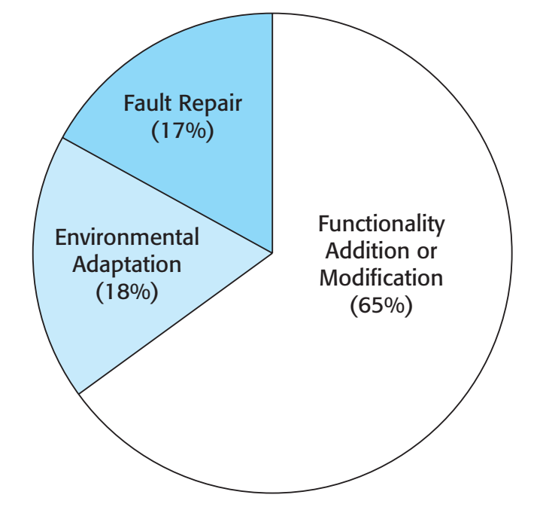
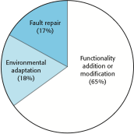
Figure 9.8 Maintenance effort distribution

Slide 27
Maintenance costs
Usually greater than development costs (2* to 100* depending on the application).
Affected by both technical and non-technical factors.
Increases as software is maintained. Maintenance corrupts the software structure so makes further maintenance more difficult.
Ageing software can have high support costs (e.g. old languages, compilers etc.).

Slide 28
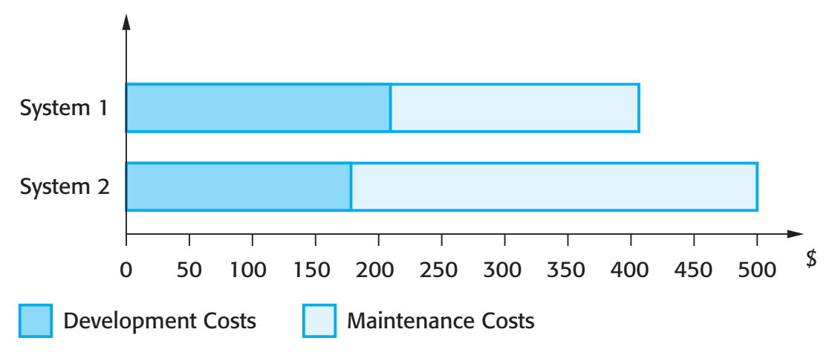
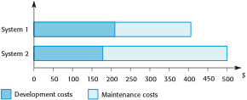
Figure 9.9 Development and maintenance costs

Slide 29
Maintenance cost factors
Team stability
Maintenance costs are reduced if the same staff are involved with them for some time.
Contractual responsibility
The developers of a system may have no contractual responsibility for maintenance so there is no incentive to design for future change.
Staff skills
Maintenance staff are often inexperienced and have limited domain knowledge.
Program age and structure
As programs age, their structure is degraded and they become harder to understand and change.

Slide 30
Maintenance prediction
Maintenance prediction is concerned with assessing which parts of the system may cause problems and have high maintenance costs
Change acceptance depends on the maintainability of the components affected by the change;
Implementing changes degrades the system and reduces its maintainability;
Maintenance costs depend on the number of changes and costs of change depend on maintainability.

Slide 31
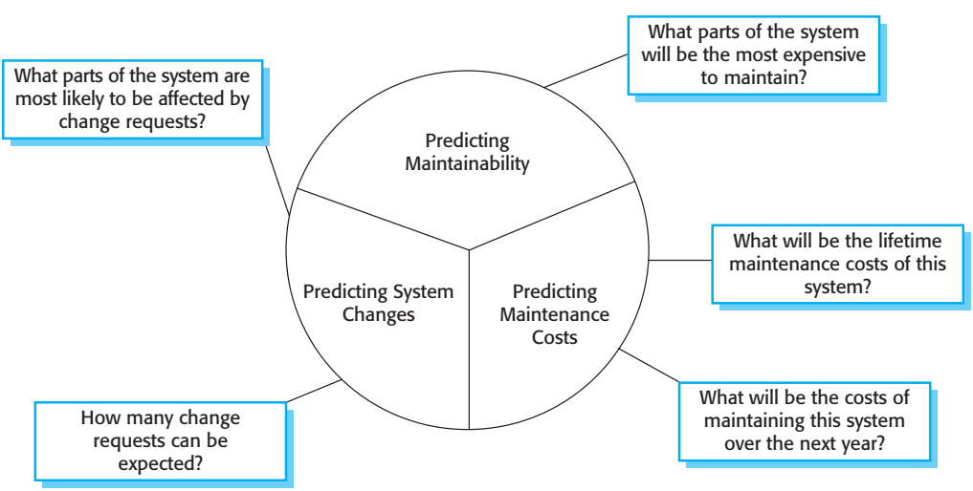
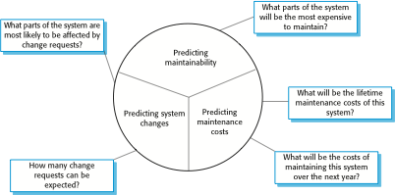
Maintenance prediction

Slide 32
Change prediction
Predicting the number of changes requires and understanding of the relationships between a system and its environment.
Tightly coupled systems require changes whenever the environment is changed.
Factors influencing this relationship are
Number and complexity of system interfaces;
Number of inherently volatile system requirements;
The business processes where the system is used.

Slide 33
Complexity metrics
Predictions of maintainability can be made by assessing the complexity of system components.
Studies have shown that most maintenance effort is spent on a relatively small number of system components.
Complexity depends on
Complexity of control structures;
Complexity of data structures;
Object, method (procedure) and module size.

Slide 34
Process metrics
Process metrics may be used to assess maintainability
Number of requests for corrective maintenance;
Average time required for impact analysis;
Average time taken to implement a change request;
Number of outstanding change requests.
If any or all of these is increasing, this may indicate a decline in maintainability.

Slide 35
System re-engineering
Re-structuring or re-writing part or all of a legacy system without changing its functionality.
Applicable where some but not all sub-systems of a larger system require frequent maintenance.
Re-engineering involves adding effort to make them easier to maintain. The system may be re-structured and re-documented.

Slide 36
Advantages of reengineering
Reduced risk
There is a high risk in new software development. There may be development problems, staffing problems and specification problems.
Reduced cost
The cost of re-engineering is often significantly less than the costs of developing new software.

Slide 37
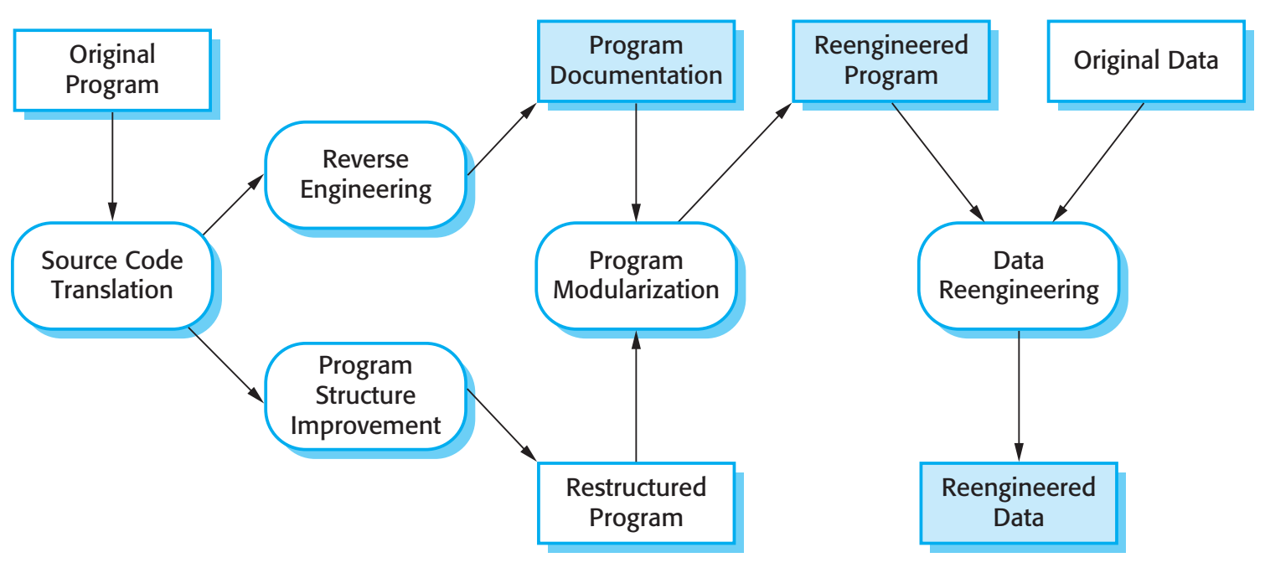
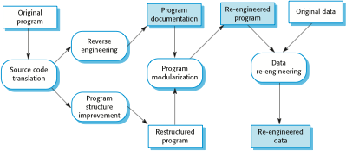
The reengineering process

Slide 38
Reengineering process activities
Source code translation
Convert code to a new language.
Reverse engineering
Analyse the program to understand it;
Program structure improvement
Restructure automatically for understandability;
Program modularisation
Reorganise the program structure;
Data reengineering
Clean-up and restructure system data.

Slide 39
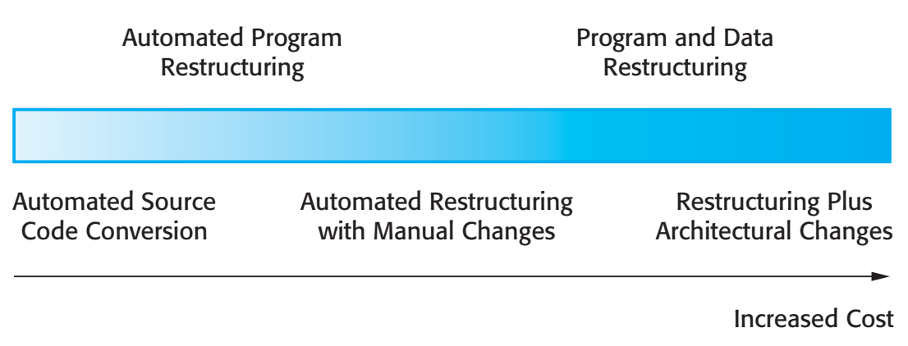
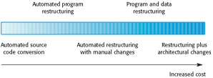
Figure 9.12 Reengineering approaches

Slide 40
Reengineering cost factors
The quality of the software to be reengineered.
The tool support available for reengineering.
The extent of the data conversion which is required.
The availability of expert staff for reengineering.
This can be a problem with old systems based on technology that is no longer widely used.

Slide 41
Preventative maintenance by refactoring
Refactoring is the process of making improvements to a program to slow down degradation through change.
You can think of refactoring as ‘preventative maintenance’ that reduces the problems of future change.
Refactoring involves modifying a program to improve its structure, reduce its complexity or make it easier to understand.
When you refactor a program, you should not add functionality but rather concentrate on program improvement.

Slide 42
Refactoring and reengineering
Re-engineering takes place after a system has been maintained for some time and maintenance costs are increasing. You use automated tools to process and re-engineer a legacy system to create a new system that is more maintainable.
Refactoring is a continuous process of improvement throughout the development and evolution process. It is intended to avoid the structure and code degradation that increases the costs and difficulties of maintaining a system.

Slide 43
‘Bad smells’ in program code
Duplicate code
The same or very similar code may be included at different places in a program. This can be removed and implemented as a single method or function that is called as required.
Long methods
If a method is too long, it should be redesigned as a number of shorter methods.
Switch (case) statements
These often involve duplication, where the switch depends on the type of a value. The switch statements may be scattered around a program. In object-oriented languages, you can often use polymorphism to achieve the same thing.

Slide 44
‘Bad smells’ in program code
Data clumping
Data clumps occur when the same group of data items (fields in classes, parameters in methods) re-occur in several places in a program. These can often be replaced with an object that encapsulates all of the data.
Speculative generality
This occurs when developers include generality in a program in case it is required in the future. This can often simply be removed.

Slide 45
Legacy system management
Organisations that rely on legacy systems must choose a strategy for evolving these systems
Scrap the system completely and modify business processes so that it is no longer required;
Continue maintaining the system;
Transform the system by re-engineering to improve its maintainability;
Replace the system with a new system.
The strategy chosen should depend on the system quality and its business value.

Slide 46
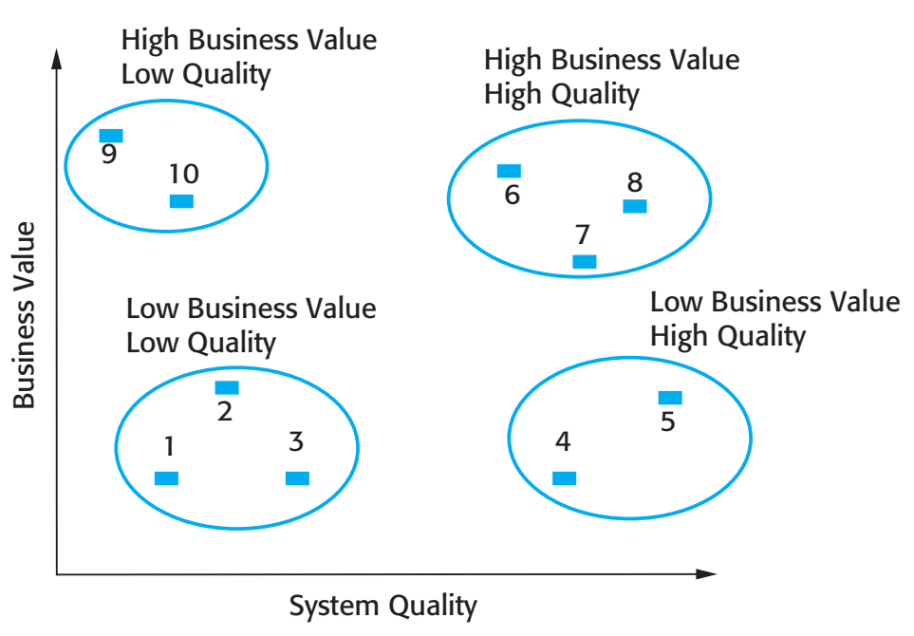
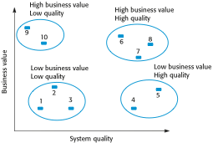
Figure 9.13 An example of a legacy system assessment

Slide 47
Legacy system categories
Low quality, low business value
These systems should be scrapped.
Low-quality, high-business value
These make an important business contribution but are expensive to maintain. Should be re-engineered or replaced if a suitable system is available.
High-quality, low-business value
Replace with COTS, scrap completely or maintain.
High-quality, high business value
Continue in operation using normal system maintenance.

Slide 48
Business value assessment
Assessment should take different viewpoints into account
System end-users;
Business customers;
Line managers;
IT managers;
Senior managers.
Interview different stakeholders and collate results.

Slide 49
Issues in business value assessment
The use of the system
If systems are only used occasionally or by a small number of people, they may have a low business value.
The business processes that are supported
A system may have a low business value if it forces the use of inefficient business processes.
System dependability
If a system is not dependable and the problems directly affect business customers, the system has a low business value.
The system outputs
If the business depends on system outputs, then the system has a high business value.

Slide 50
System quality assessment
Business process assessment
How well does the business process support the current goals of the business?
Environment assessment
How effective is the system’s environment and how expensive is it to maintain?
Application assessment
What is the quality of the application software system?

Slide 51
Business process assessment
Use a viewpoint-oriented approach and seek answers from system stakeholders
Is there a defined process model and is it followed?
Do different parts of the organisation use different processes for the same function?
How has the process been adapted?
What are the relationships with other business processes and are these necessary?
Is the process effectively supported by the legacy application software?
Example - a travel ordering system may have a low business value because of the widespread use of web-based ordering.

Slide 52
Factors used in environment assessment
Factor | Questions
Supplier stability | Is the supplier still in existence? Is the supplier financially stable and likely to continue in existence? If the supplier is no longer in business, does someone else maintain the systems?
Failure rate | Does the hardware have a high rate of reported failures? Does the support software crash and force system restarts?
Age | How old is the hardware and software? The older the hardware and support software, the more obsolete it will be. It may still function correctly but there could be significant economic and business benefits to moving to a more modern system.
Performance | Is the performance of the system adequate? Do performance problems have a significant effect on system users?

Slide 53
Factors used in environment assessment
Factor | Questions
Support requirements | What local support is required by the hardware and software? If there are high costs associated with this support, it may be worth considering system replacement.
Maintenance costs | What are the costs of hardware maintenance and support software licenses? Older hardware may have higher maintenance costs than modern systems. Support software may have high annual licensing costs.
Interoperability | Are there problems interfacing the system to other systems? Can compilers, for example, be used with current versions of the operating system? Is hardware emulation required?

Slide 54
Factors used in application assessment
Factor | Questions
Understandability | How difficult is it to understand the source code of the current system? How complex are the control structures that are used? Do variables have meaningful names that reflect their function?
Documentation | What system documentation is available? Is the documentation complete, consistent, and current?
Data | Is there an explicit data model for the system? To what extent is data duplicated across files? Is the data used by the system up to date and consistent?
Performance | Is the performance of the application adequate? Do performance problems have a significant effect on system users?

Slide 55
Factors used in application assessment
Factor | Questions
Programming language | Are modern compilers available for the programming language used to develop the system? Is the programming language still used for new system development?
Configuration management | Are all versions of all parts of the system managed by a configuration management system? Is there an explicit description of the versions of components that are used in the current system?
Test data | Does test data for the system exist? Is there a record of regression tests carried out when new features have been added to the system?
Personnel skills | Are there people available who have the skills to maintain the application? Are there people available who have experience with the system?

Slide 56
System measurement
You may collect quantitative data to make an assessment of the quality of the application system
The number of system change requests;
The number of different user interfaces used by the system;
The volume of data used by the system.

Slide 57
Key points
There are 3 types of software maintenance, namely bug fixing, modifying software to work in a new environment, and implementing new or changed requirements.
Software re-engineering is concerned with re-structuring and re-documenting software to make it easier to understand and change.
Refactoring, making program changes that preserve functionality, is a form of preventative maintenance.
The business value of a legacy system and the quality of the application should be assessed to help decide if a system should be replaced, transformed or maintained.

